Slide 1

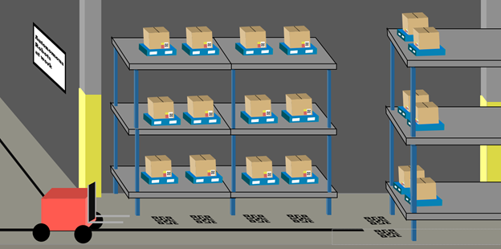
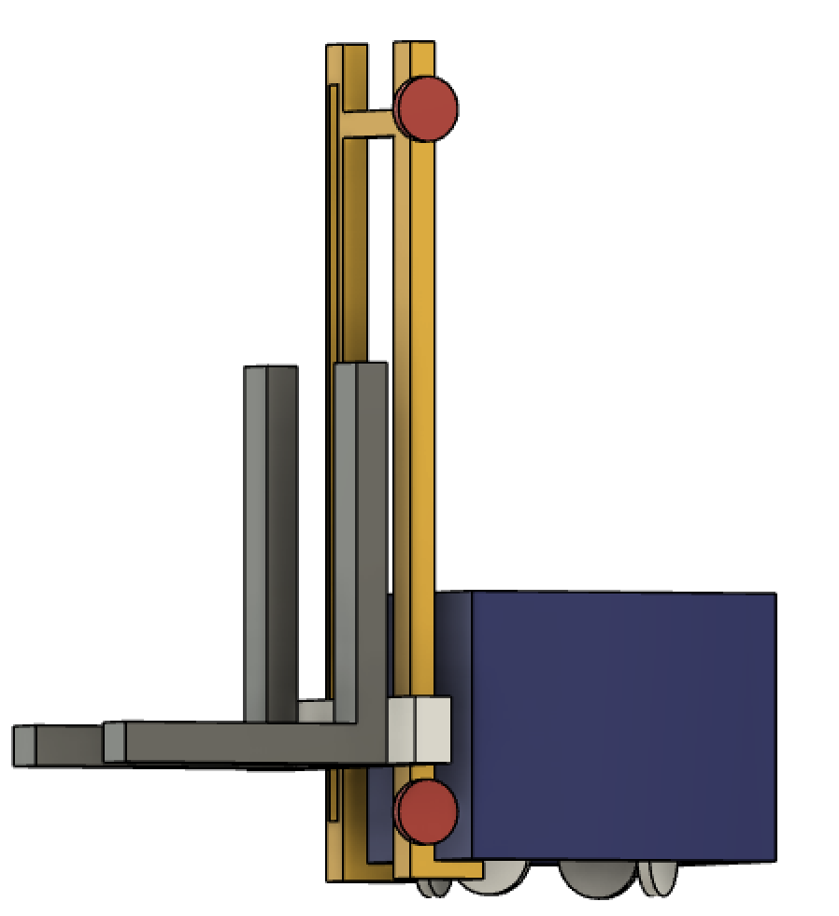
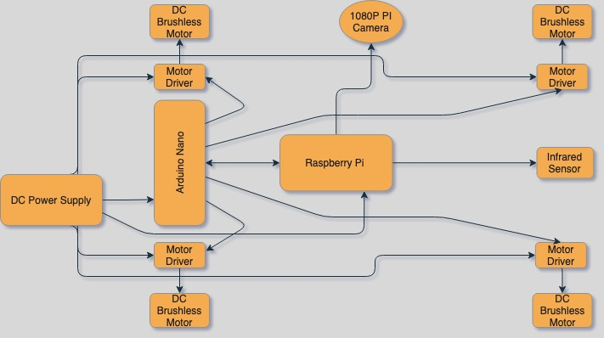




T311 - Material Handling Robot
Team Members: Alexandar Jen, Walter Caldwell, Sebastian Muriel, Tiffany Miller, Tony Zheng
Instructors: Dr. Oscar Chuy & Dr. Jerris Hooker Faculty Advisor: Dr. Bruce Harvey
Abstract
Design
There is a demand for robotic workers in warehouses for the purpose of increasing productivity and reducing worker liability. Since the main goal is to reduce the number of human workers to zero, an autonomous fleet of robots is an ideal workforce. Thus, the purpose of this project is to create an autonomous robot that can manipulate inventory around the warehouse.
An Arduino Due will be used to control the motors
A raspberry pi will be used to control navigation with a line sensor. It will also control the camera module to identify packages and update inventory.
Problem
Warehouses need to increase productivity to meet increasing demands.
Worker injuries need to be reduced as well as employee turnover.
Current robotic alternatives are expensive and too large.
Objective:
The objective of this project is to create a partially autonomous material handling robot that works in a dark warehouse with conditions unfavorable to human workers.
Block Diagram
Scope
Future Work
Load of 25 lb
Navigates autonomously
Recognizes packages
Self-loading and dropoff
Assemble prototype
Test prototype movement and lifting mechanisms with manual inputs
Design navigation and databasing algorithms
Test algorithms and prototype’s autonomous movements
Notes:
https://ww2.eng.famu.fsu.edu/me/senior_design/2017/team22/docs_pdfs/FinalPoster.pdf

